Slide 1
Big DATA Project
Yanjun jiang & Xuan Yan 11/17/2019

Slide 2
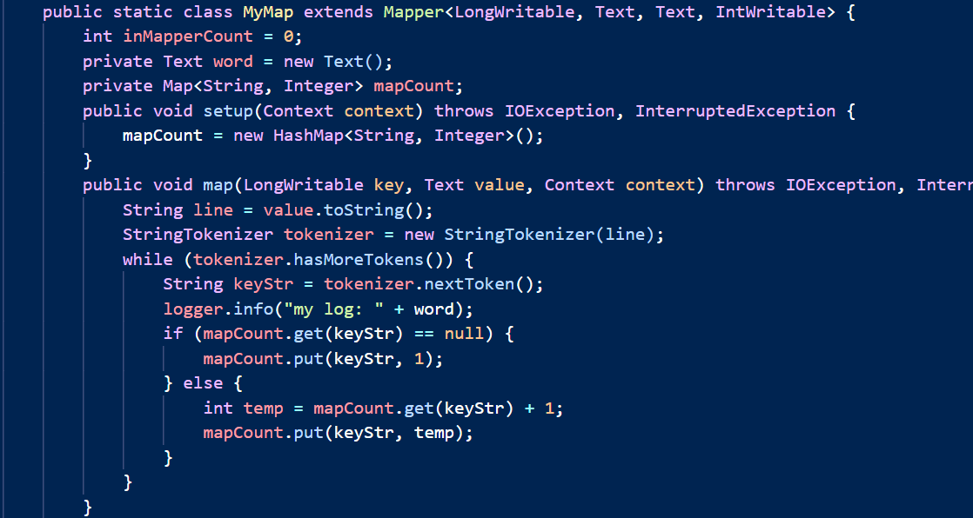
Java code In Mapper WordCount Mapper 1

Slide 3
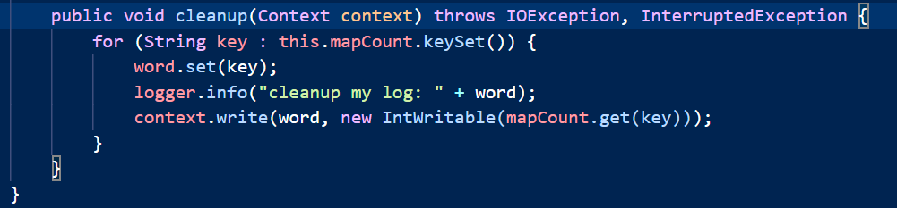
Java code In Mapper WordCount Mapper 2

Slide 4
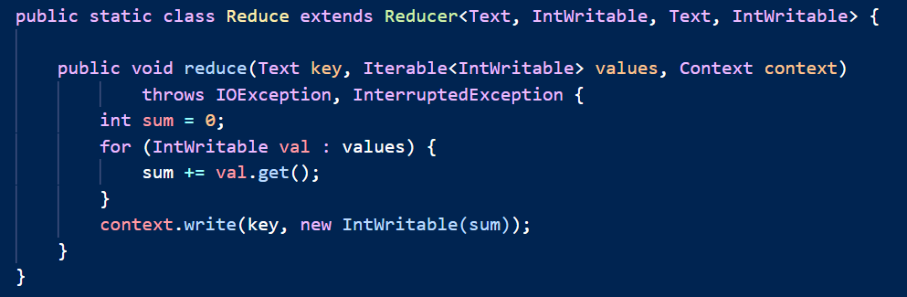
Java code In Mapper WordCount Reducer

Slide 5
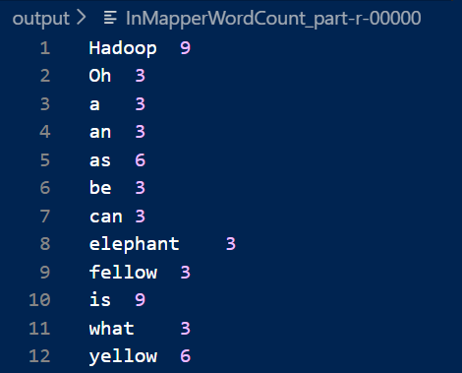
In Mapper WordCount OUTPUT

Slide 6
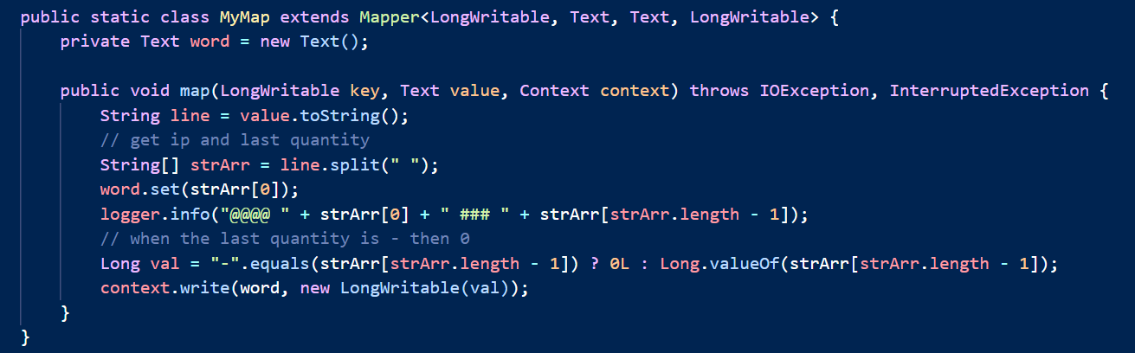
Java code Average Mapper

Slide 7
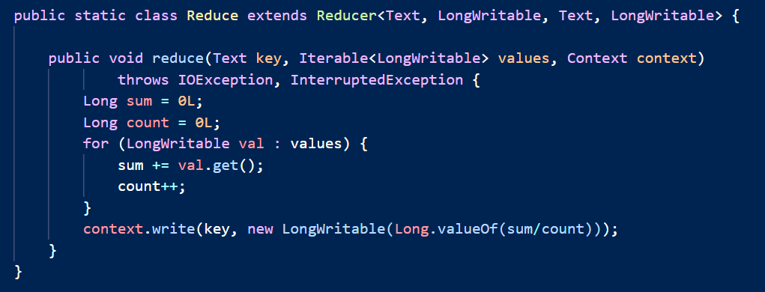
Java code Average reducer

Slide 8
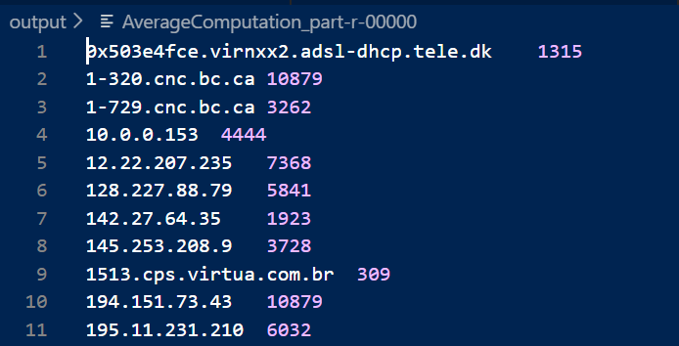
Output of Average

Slide 9
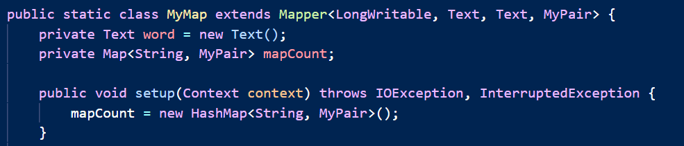
Java code In Mapper Average Mapper 1

Slide 10
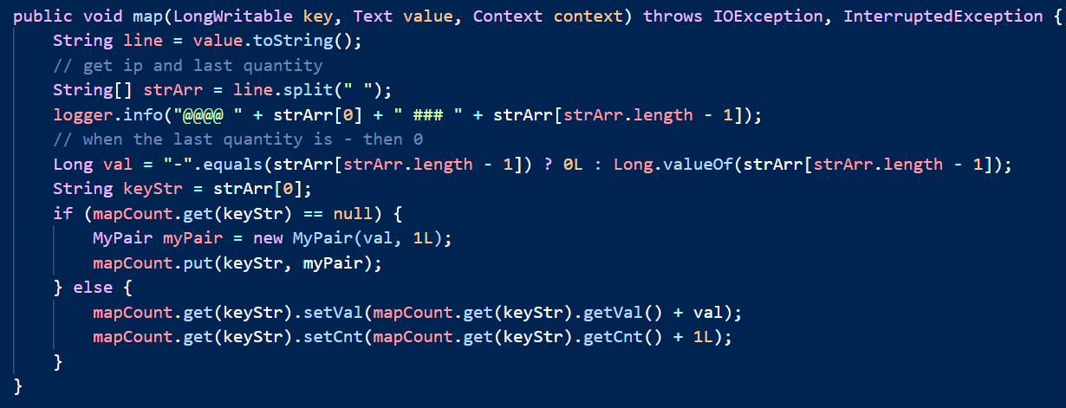
Java code In Mapper Average Mapper 2

Slide 11
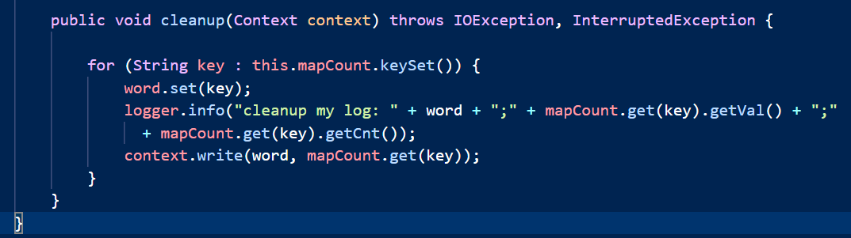
Java code In Mapper Average Mapper 3

Slide 12
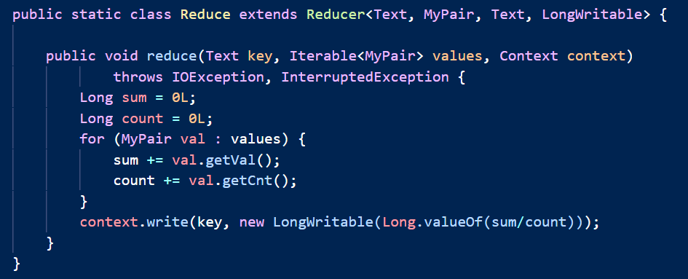
Java code In Mapper Average Reducer

Slide 13
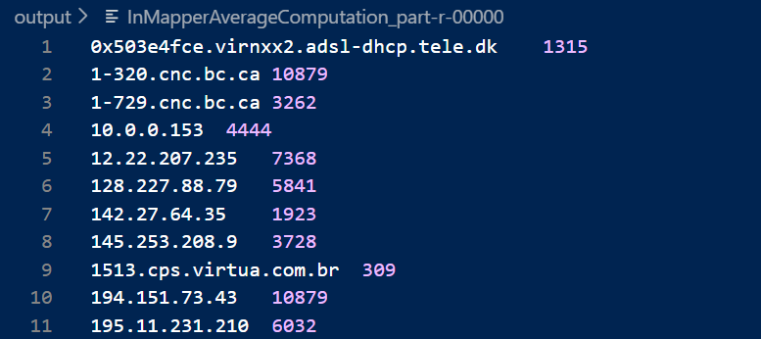
Output of In Mapper Average

Slide 14
Pseudo code for PAIR approach
class Mapper method Map(docid a; doc d) for all term u in record r do for all term v in Window(u) do Emit((u, v), 1) Emit((u, *), 1) | class Reducer method initialize() sum = 0 method Reduce(Pair (u, v), Integer [c1, c2, …]) s = 0 for all count c in counts [c1, c2, …] do s = s + c if (v == “*”) sum = s else Emit((u, v), s / sum)

Slide 15
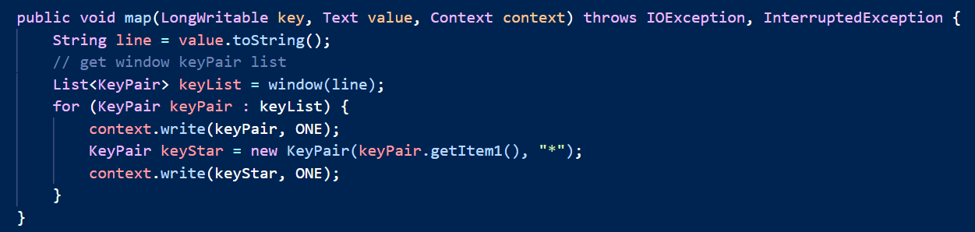
Java code for PAIR approach Mapper

Slide 16
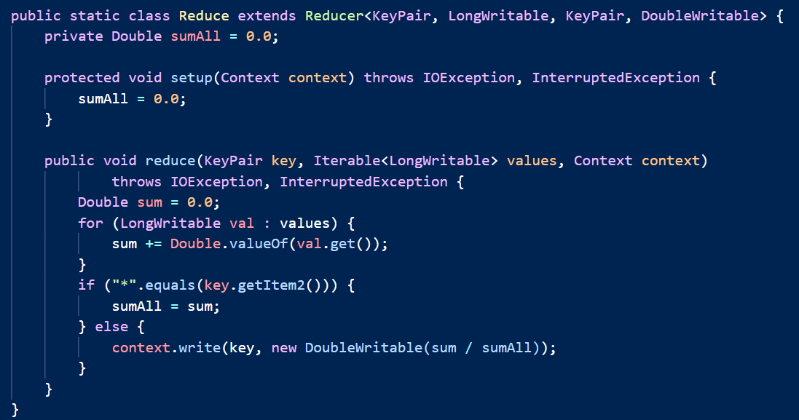
Java code for PAIR approach reducer

Slide 17
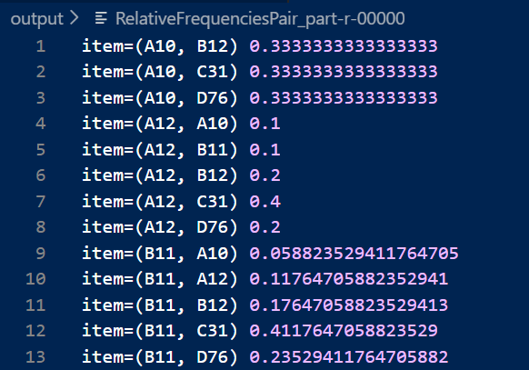
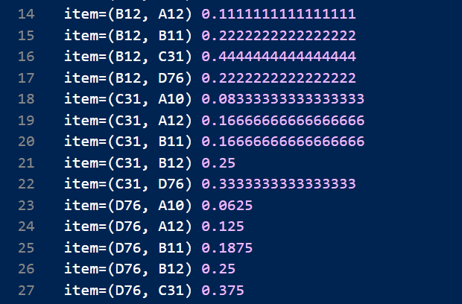
Result of PAIR approach

Slide 18
Pseudo code for STRIPE approach
class Mapper method Map(docid a; doc d) for all term u in record r do H = new AssociativeArray for all term v in Window(u) do H{v} = H{v} + 1 . //Tally words co-occurring with u Emit(u, H) | class Reducer method Reduce(u, [H1, H2, H3, …]) Hf = new AssociativeArray for all stripe H in [H1;H2;H3; …] do Hf = Hf + H //Element-wise addition s = Sum(Hf ) // Sum of all elements in H f Emit(u, Hf /s) // Divide each element by s

Slide 19
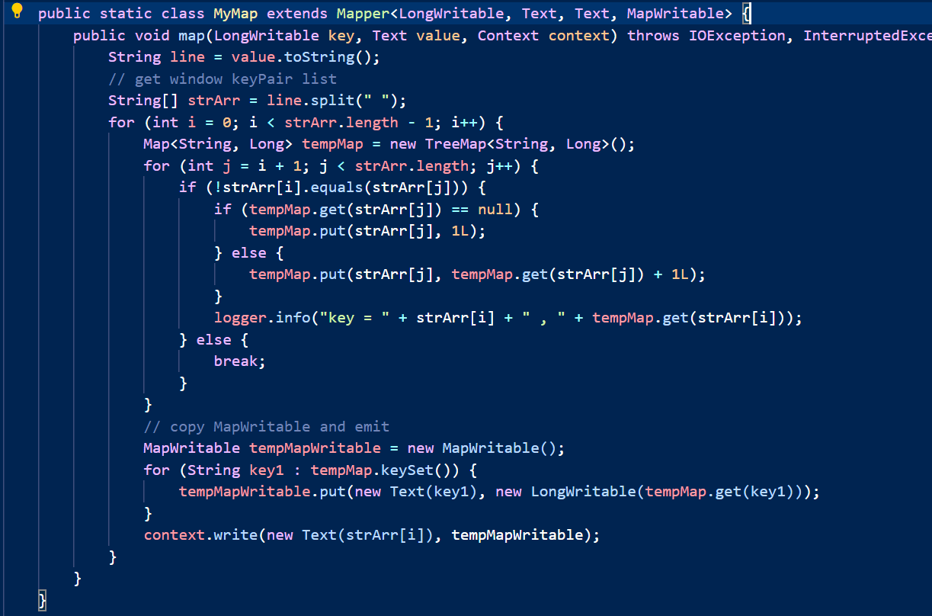
Java code for STRIPE approach Mapper

Slide 20
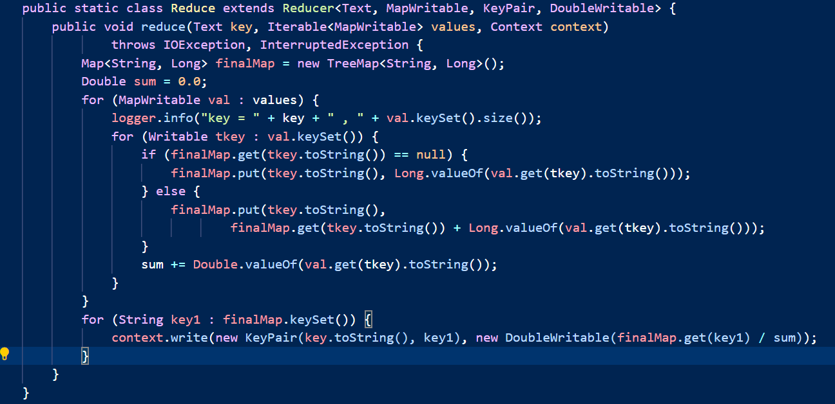
Java code for STRIPE approach reducer

Slide 21
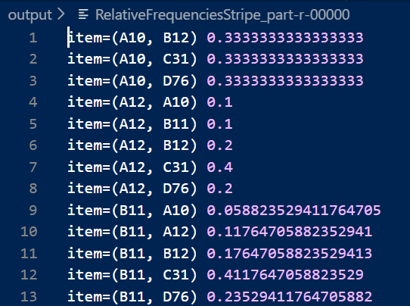
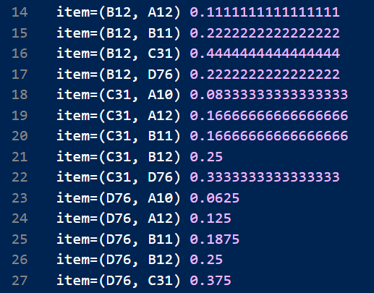
Result of STRIPE approach

Slide 22
Pseudo code for HYBRID approach
class Mapper method Map(docid a; doc d) for all term u in record r do for all term v in Window(u) do Emit((u, v), 1) | class Reducer method initialize() total = 0 sum = 0 uPrev = null method Reduce((u,v), [c1, c2, c3, …]) for all c in [c1;c2;c3; …] do sum += c if (uPrev <> u and uPrev <> null) total = total(H) //add all value in H H = H / total Emit(uPrev, H) sum = 0 H = new AssociativeArray H{v} = sum uPrev = u method close() total = total(H) //add all value in H H = H / total Emit(uPrev, H)

Slide 23
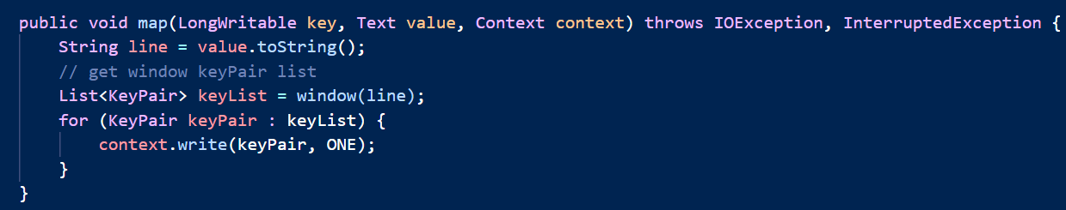
Java code for HYBRID approach Mapper

Slide 24
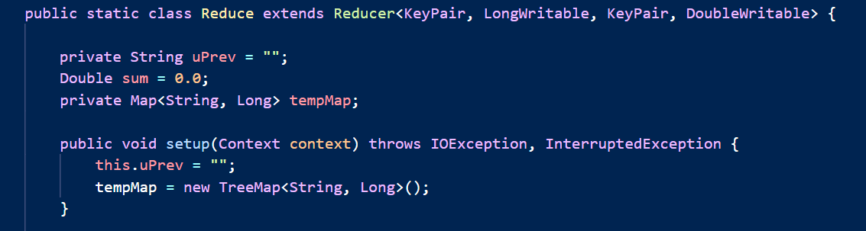
Java code for HYBRID approach Reducer setup

Slide 25
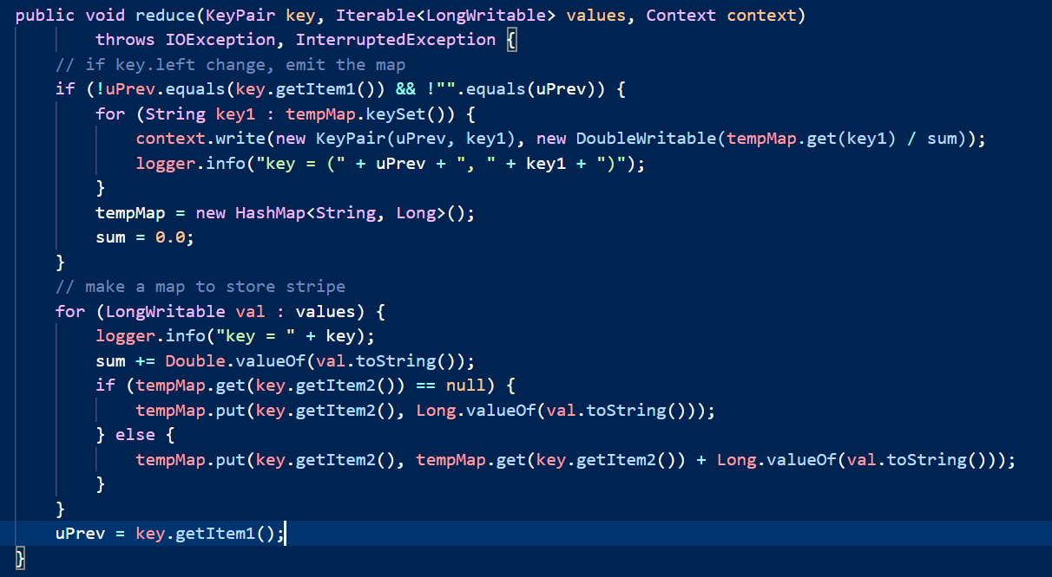
Java code for HYBRID approach Reducer reduce

Slide 26
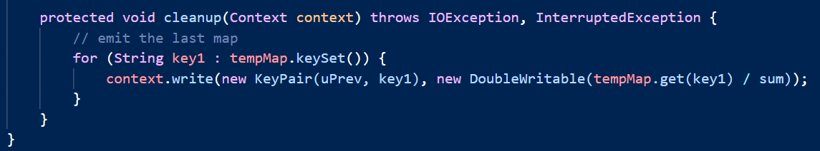
Java code for HYBRID approach Reducer close

Slide 27
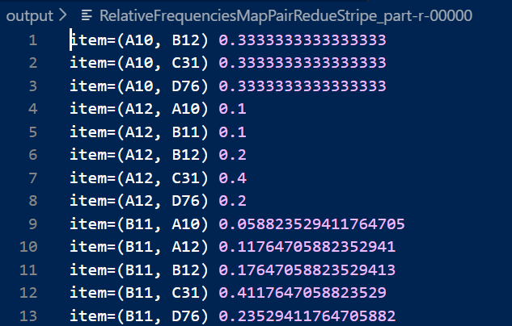
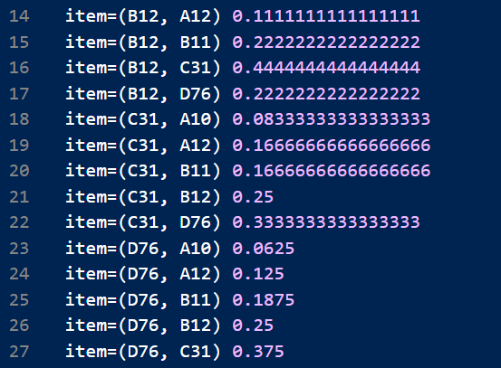
Result of HYBRID approach

Slide 28
Time and resource comparison : Pair-Stripe-Hybrid
Comparison (same input) | Time | Resource
Pair | Time used:32735ms | Use least memory, but most network
Stripe | Time used:49751ms | Use a HashMap to store the output of Mapper Use a HashMap to store the output of Reducer Use least network
Hybrid | Time used:34224ms | Use a HashMap to store the output of Reducer Use less network than Pair, but more network than Stripe

Slide 29
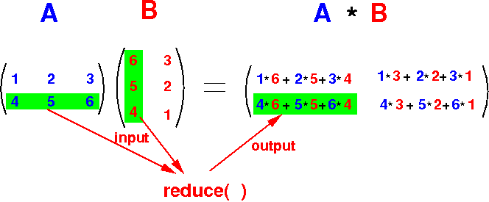
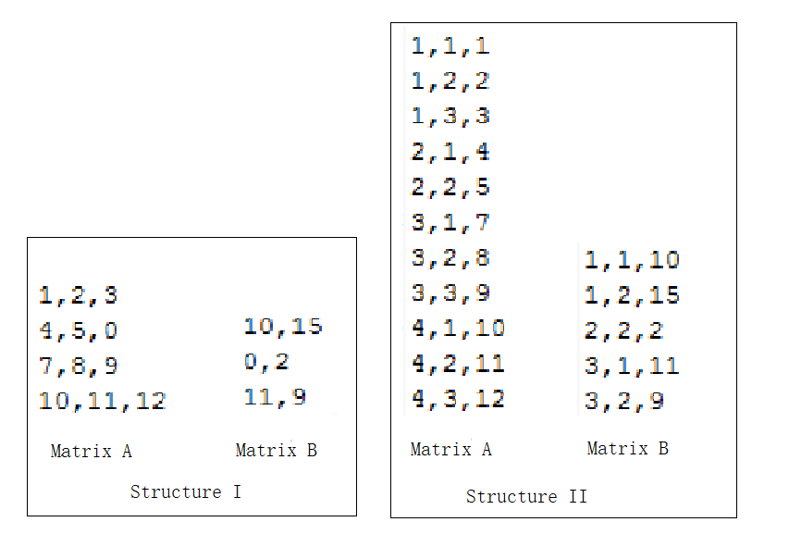
TEAM CHALLENGE ---- MATRIX Multiplication
How to multiply two matrixes, if the two matrixes are huge can’t put into memory of one computer
Normally, it’s a spare matrix we have to deal with. So we can save matrix into two structure as below

Slide 30
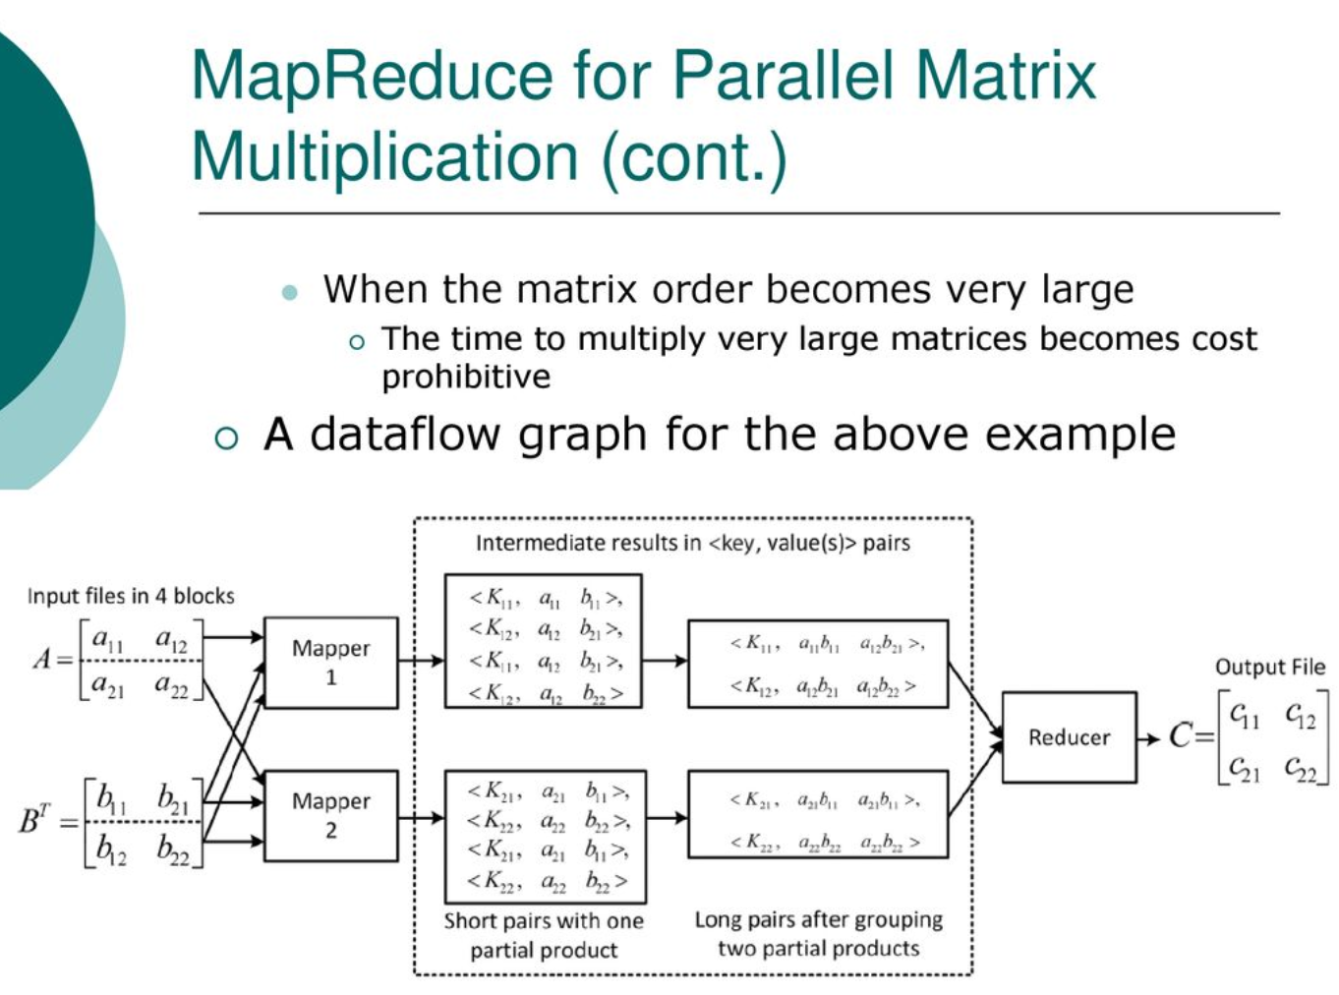
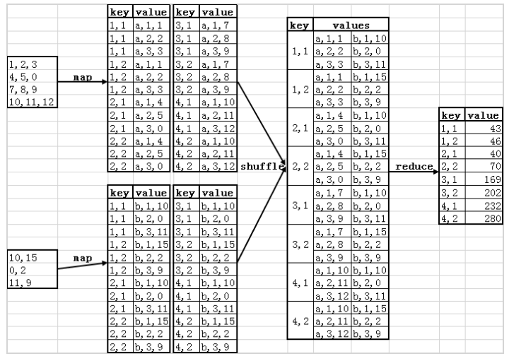
How to use map Reduce

Slide 31
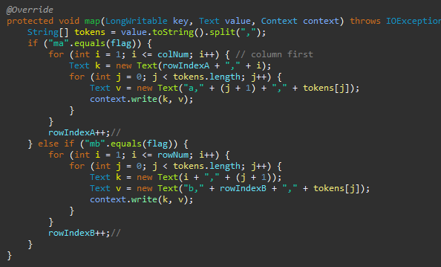
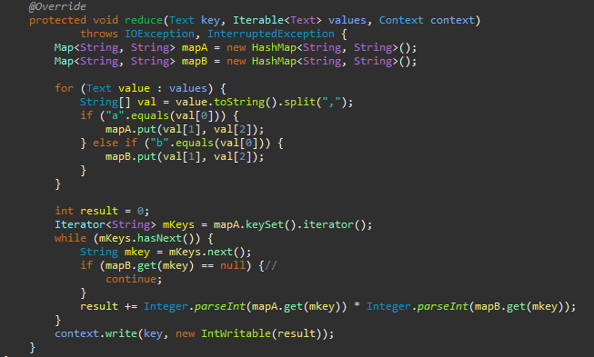
MATRIX Multiplication ---- Code
Map and reduce

Slide 32
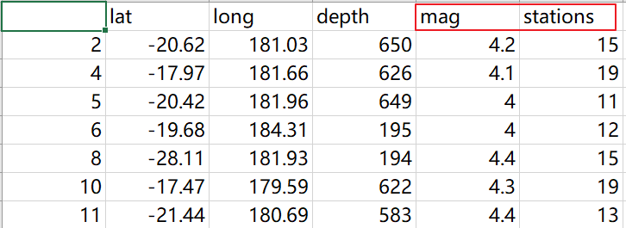
Spark project Problem statement
link to dataset
The original data link: https://vincentarelbundock.github.io/Rdatasets/csv/datasets/quakes.csv
Simplified data link: https://github.com/jij000/big-data-project/blob/master/sparkScalaTest/quakes.csv
categorical variable chosen and numeric variable chosen)
categorical variable: stations
numeric variable: mag -- Magnitude
Problem statement
These data shows the magnitude of earthquakes happened in every stations in Fiji
Bootstrapping technique can tell us how strong an earthquake will happen in a particular station

Slide 33
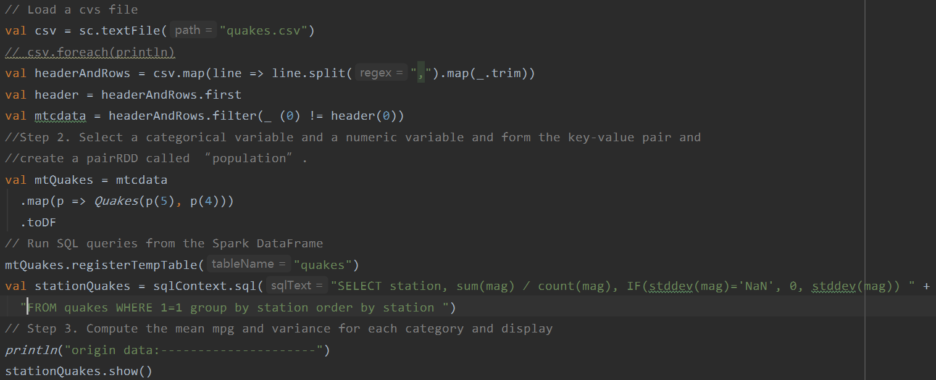
Scala code 1

Slide 34
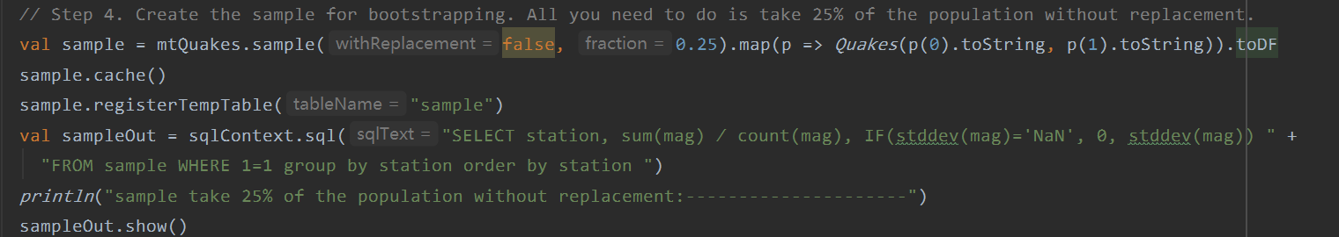
Scala code 2

Slide 35
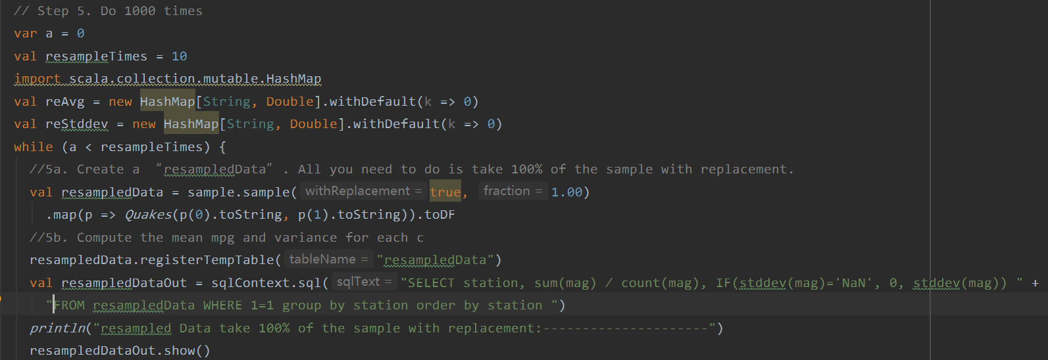
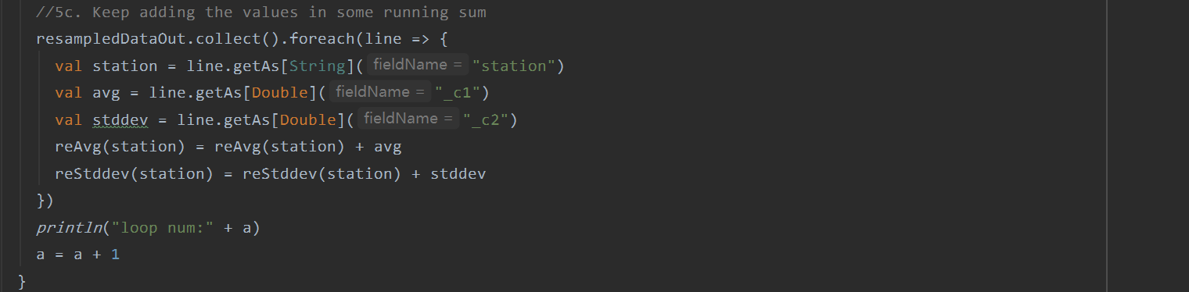
Scala code 3

Slide 36
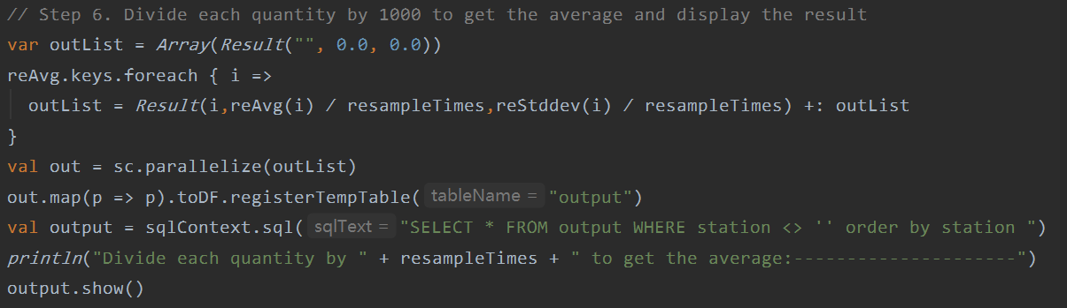
Scala code 4

Slide 37
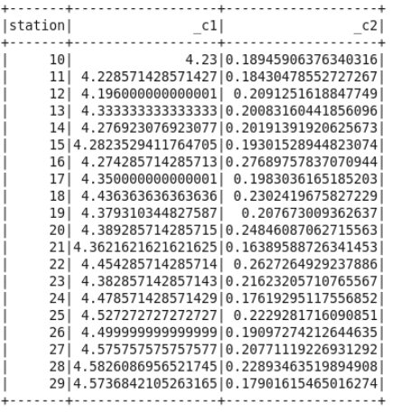
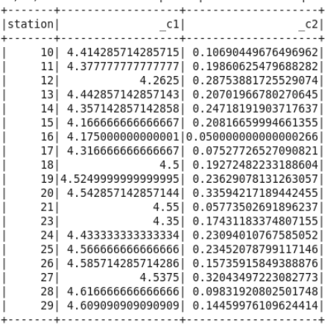
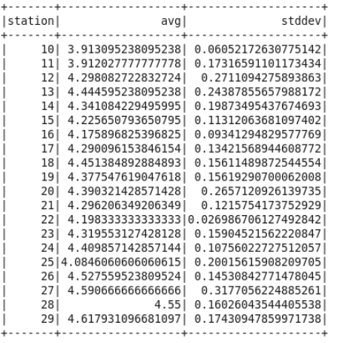
output
take 25% of the original data
without replacement
Divide each quantity by 10 to get
the average and display the result
The original data

